Slide 1


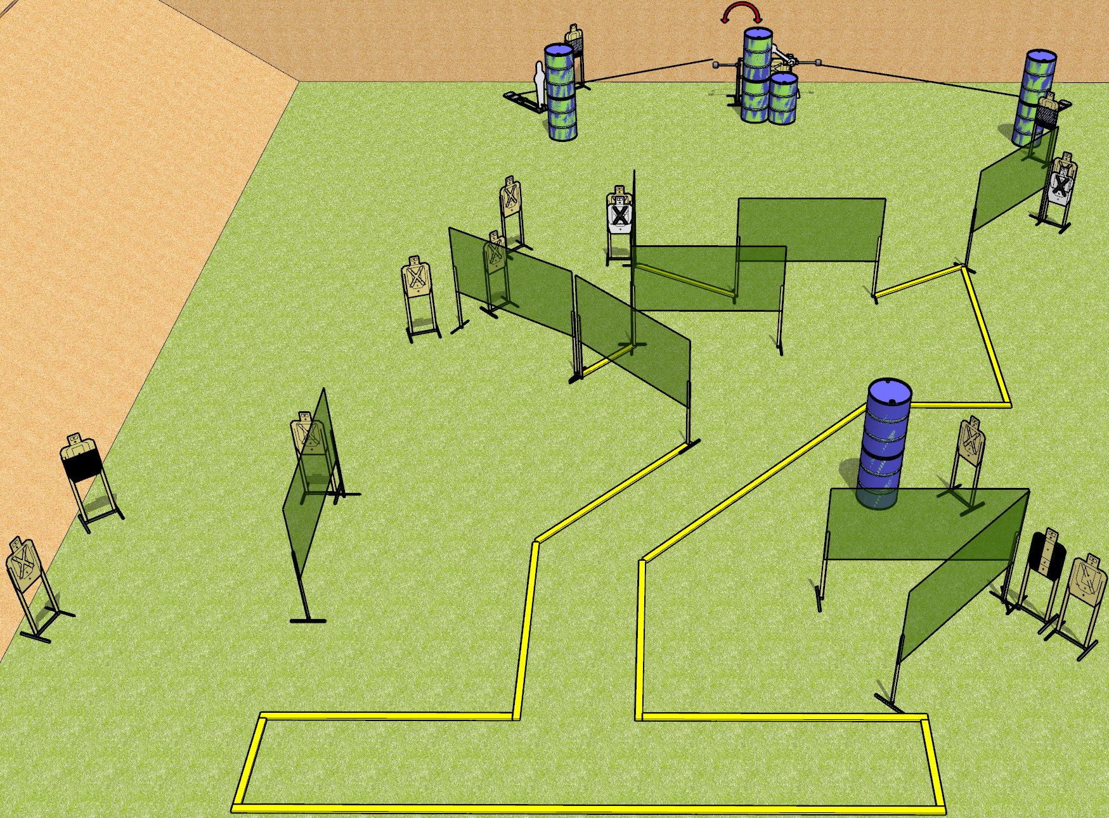
 | Dothan Gun Club – USPSA Match All Bent Up Course Designer : Drew Coleman
START POSITION : Standing with both heels against the rearmost fault line, inside the shooting area, wrists below belt
GUN READY CONDITION : Pistol loaded and holstered. PCC loaded, shouldered, safety on, pointed at orange cone. |  | SCORING: Comstock, 32 rounds TARGETS: 14 paper, 4 Steel SCORED HITS: Best 2 on paper, steel until down START-STOP: Audible, last shot RULES: all moving targets must be activated before being engaged
STAGE PROCEDURE: Engage targets as they become available from within the fault lines.

Slide 2
All Bent Up
Written Stage Briefing
All Bent Up is a 32 round, 160 point, Comstock field course. There are fifteen USPSA targets, two falling plates, and two pepper poppers. The best two hits on paper will score and the steel must fall to score. The start signal is audible.
Left pepper popper activates left swinger. Right pepper popper activates the swinging plate target. Please view the activator setup prior to first shooter and reset it the same way every time.
Handgun start position is standing with both heels against the rearmost fault line, inside the shooting area, wrists below belt. Handgun is loaded and holstered.
PCC start position is standing with both heels against the rearmost fault line, inside the shooting area, muzzle pointed at orange cone. Loaded carbine is held with both hands, safety on.
On start signal engage targets as they become available from within the shooting area.

